Slide 1
Coffee Sales Trend analysis

Slide 2
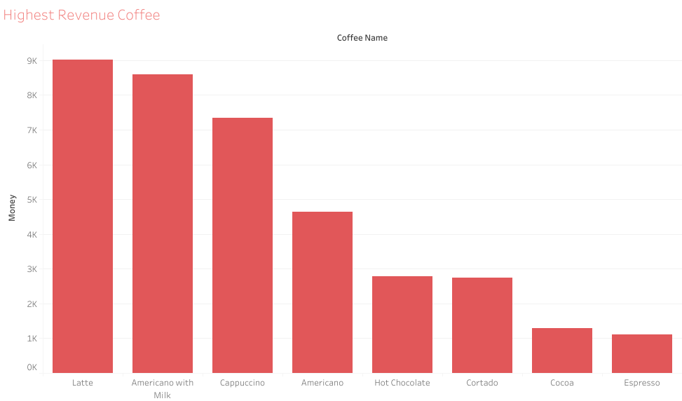

Slide 3
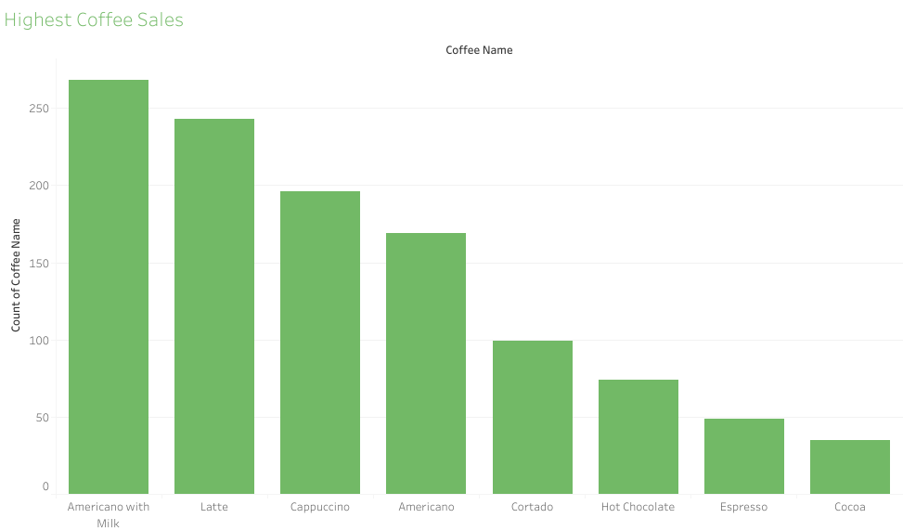

Slide 4


Slide 5
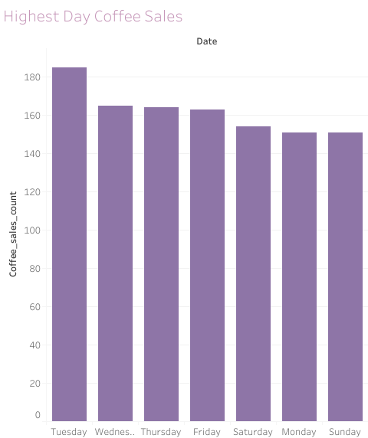

Slide 6


Slide 7


